Slide 1

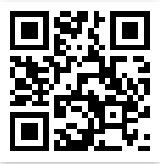
Ransomware Orel Rahum Harel Berger and Dr. Amit Dvir
my goal is to detection ransomware attack
ransomware is a type of malware that prevents users from accessing their system
or personal les and demands ransom payment in order to regain access.
3. Methods/algorithms/Alternatives or Design Considerations
4. Selected Approach
5. Solution Description (Algorithms, Modulation, Patterns, Infrastructure, UI, Functionality)
Visit Us
Scan QRCode for full Instructions

